Slide 1
Forecasting Rubber Export volume of Indonesia

Slide 2
Timeline
Go Beta by 1st March 2020
Achieve the accuracy metrics by 1st May 2020
Go Live by 1st August 2020

Slide 3
Deliverables
Two separate AI models to forecast monthly Rubber export volume of Indonesia for a year-to-come.
Statistical model
Deep Neural Network
A verification system to cross-check AI based prediction.
A Graphical Interface to interact with the core of the AI.
To understand the factors impacting the export volume at any given time.
Ability to alter the given factors to get optimized volume figures.
An AI based system to identify potential individuals to connect with for cargo.

Slide 4
Prototype : Forecast (Releasing with Stage 1)

Slide 5
Prototype : Forecast Verification (Releasing with Stage 2)

Slide 6
Prototype : Forecast Manipulation (Releasing with Stage 2)

Slide 7
Cross Validation System (Releasing with Stage 3)

Slide 8
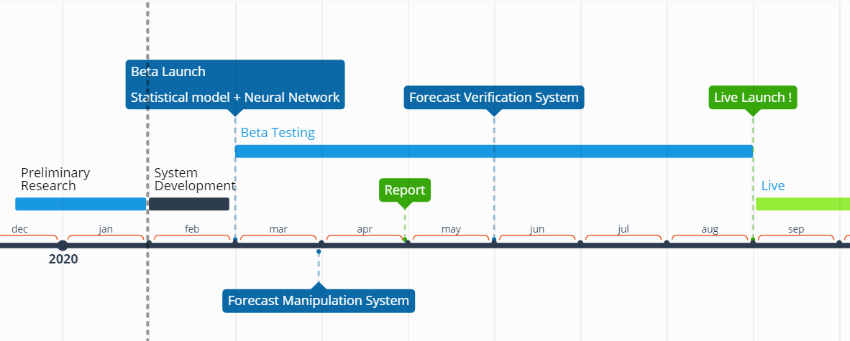
The Timeline

Slide 9
Q & A

Slide 10
Thank you!

